Slide 1
CRITICAL CONVERSATIONS: CHILD DEVELOPMENT AND MENTAL HEALTH
SEXUAL ORIENTATION
AND IDENTITY
Eric Boyum, MD
Peter Daniolos, MD
Notes:
Welcome.

Slide 2
OBJECTIVES
Construct (and/or review) framework to describe variability in gender and sexuality in children, adolescents, and young adults.
Learn of several theories of psychosexual development in children, adolescents, and young adults, that can provide developmental context for the presentation of clinical problems.
Understand some of the developmental challenges that sexual minority youth might face.
Discuss how we might help, and how to avoid harm.
Notes:
Purpose
-Various developmental trajectories of normal sexuality
-Various ways of understanding development of normal sexuality
-Brief discussion of developmental challenges facing sexual minority youth
- Typical reactions of patients and families around development of a sexual minority identity.
- Role of physicians and child development experts to normalize this developmental trajectory, to monitor at-risk youth, and provide reassurance to families.

Slide 3
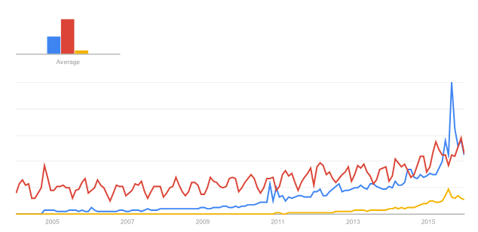
INTRODUCTION
Creative and less rigid identity constructs
have led to the development of new identities
… to describe what has likely always been a
more dynamic continuum of sexual experience
and expression for individuals.
Asexual
Pansexual
Demisexual
Data Source: Google Trends
Notes:
A discussion of modern sexual minority youth is a different conversation than would have occurred 20 years ago. Over the past few decades, the drive for community among sexual minorities, which led many to self-identify in somewhat limited constructs in order to find support and role models, has given way to a new generation of sexual minority youth who prize individuality, creativity, and non-conformity. Mass communications and the Internet has allowed people who would likely have been excluded from the more rigid categorizations of previous generations, to explore sexual identities outside of these limited constructs.

Slide 4
Theoretical conceptualizations
Gender role: culturally underwritten masculine and feminine behaviors, attitudes and personality traits.
Gender identity: internally perceived gender, regardless of natal or assigned gender.
Gender expression: a person’s manifestation of masculine or feminine behaviors, mannerisms, speech, and physical appearance
Sexual orientation: predominance of erotic feelings, thoughts, and fantasies regarding one or more than one sex.
Sexual identity: a person’s self-concept as a sexual being, and practically, the label one uses to label him- or herself.
Notes:
Definitions of gender and sexuality.
Focus today on the latter 2 definitions, though will reference gender non-conformity (non-conforming ‘gender expression’) in relation to later non-heterosexual orientation / identity.

Slide 5
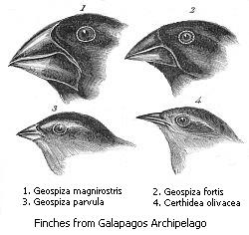
THEORETICAL CONCEPTUALIZATIONS
Notes:
Variation – key to evolutionary process
Angelwing shell color- fitness related to predator/camoflauge
Darwin’s finches (Peter and Rosemary Grant/Princeton)- fitness related to beak size; The Beak of the Finch (1995) by Johnathan Weiner (won 1995 Pulitzer Prize)
Sexuality- homosexuality originally hypothesized to grant evolutionary fitness due to assistance with rearing relative’s (sharing genetic material) offspring or “opportunistic” mating with opposite sex partners… but with no clear evidence for these theories in nature. More recent data suggest that in a set of Australian twins, evolutionary advantage of homosexual twins over the heterosexual twin due to associated heritable sexual behavior (Burri, A., T. Spector, and Q. Rahman, Common genetic factors among sexual orientation, gender nonconformity, and number of sex partners in female twins: implications for the evolution of homosexuality. J Sex Med, 2015. 12(4): p. 1004-11).
The variability in sexual orientation and identity among (human) adults has been apparent for a long time. Freud first commented that latent and/or conscious sexual desires were manifest along a continuum of masculine and feminine objects. Kinsey found as early as the 1940s that both adult men and women displayed a high degree of variability around erotic desires, fantasies, and behaviors, ie sexual orientation.

Slide 6
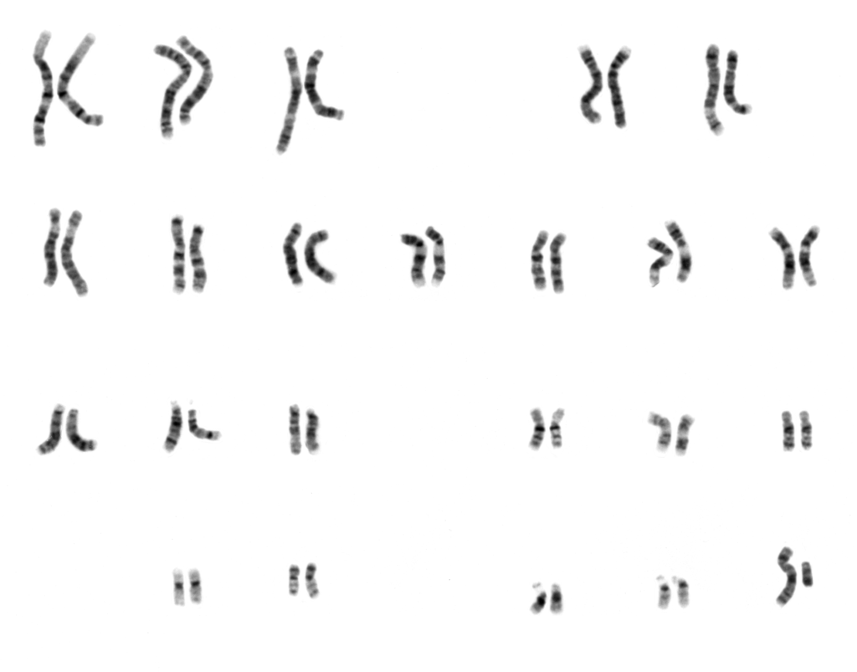
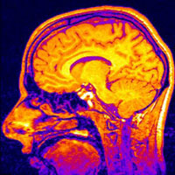
THEORETICAL CONCEPTUALIZATIONS
Notes:
More and more evidence for biological substrate of sexual orientation is being uncovered with respect to genetics, differences in neural anatomy and connectivity, and the influence of prenatal hormone milieu.

Slide 7
THEORETICAL CONCEPTUALIZATIONS
Notes:
Biological substrate may contribute more to gender atypicality in children who will grow up to be sexual minorities (evidence from recall and home videos), rather than overt sexual or romantic behavior with the same or opposite sex in childhood. Although children are not the asexual beings once believed, early researchers found it uncommon that adult sexual minorities recalled having clear sexual preferences early in life.

Slide 8
THEORETICAL CONCEPTUALIZATIONS
“In non-linear systems models, unlike epigenetic models, the fact that processes share initial and end points does not indicate that the paths joining these points are the same. Instead it leaves us free, in each case, to explore the path taken by the individual and suggests that there will often be multiple paths between various developmental points”
Galatzer-Levy, R.M., Chaotic possibilities: toward a new model of development. Int J Psychoanal, 2004. 85(Pt 2): p. 419-41.
Notes:
How then does variability in sexual orientation and identity develop? Fixed from birth? If so why do young children not pronounce their sexual desires and preferences from a very early age? Or prone to influences in childhood? Adolescence? If so then why do sexual minority teens – or heterosexual teens- not simply change their sexual orientation and/or identity depending on social milieu/pressures/etc? The variation in adolescent sexual identity development is as complex as any aspect of identity development, and while the biological, environmental, psychological and sociocultural influences leading to divergent pathways of development have not been worked out fully, very few hypothesize that there is any one answer.

Slide 9
THEORIES OF PSYCHOSEXUAL DEVELOPMENT
1. Stage Theory
2. Multidimensional Theory
3. Life Course Theory

Slide 10
Troiden’s Stages of Homosexual Development
Sensitization | A sense of feeling different from childhood peers, typically only reaching awareness in retrospect. Children feel inadequate in their natal gender roles, including not sharing interests with peers of the same gender and experiencing warmth in relation to other males that is recalled as atypical | Childhood
Identity Confusion | The suspicion one might be homosexual begins to arise, based on same-sex attractions and behaviors. Culturally assumed and mandated heterosexual identity is threatened. Youngsters may cope by trying to pass as heterosexual and may engage in heterosexual sex to prove to themselves and others that they are heterosexual. | Early Adolescence
Identity Assumption | Gradually, one begins to self-identify as homosexual and identify oneself as homosexual to others, usually in the context of social contact with other homosexuals. Youth in this stage are particularly vulnerable to stigmatization. Rural and minority youth may have a much harder time due to lack of role models and double discrimination for the latter. | Variable, but typically late adolescence.
Commitment | Finding harmony between emotional, romantic, and sexual aspects of one’s homosexual identity. Past ambivalence gives way to belief of one’s identity as “natural” and “normal.” People in this stage no longer try to “pass” as heterosexual, though may continue to “cover their homosexuality from looming too large.” There is increasing disclosure to peers and to family. Management of stigma shifts from the personal to political and educational efforts in the broader community. | Early Adulthood
Troiden, R.R., Becoming homosexual: a model of gay identity acquisition. Psychiatry, 1979. 42(4): p. 362-73.
Notes:
The idea that sexual orientation and identity unfold over time in a linear, staged way comes from multiple theorists in the 1960s. The most prominent and time-tested of these is by Richard Troiden. Troiden interviewed a number of adult openly homosexual men in the 60s and found themes in their recalled experiences of development throughout childhood and adolescence.

Slide 11
THEORIES OF PSYCHOSEXUAL DEVELOPMENT
STAGE 1: SENSITIZATION
Pre-pubertal individuals
Do not think of themselves as non-heterosexual, if they consider their sexuality at all
Do have a sense of marginalization, “difference,” mostly around gender stereotypes
Difference is recalled more in a social context than either emotional or genital contexts
Childhood home video evidence supports that boys and girls who grow up to be sexual minorities probably do have true differences in childhood gender-normative behavior/gender expression
(Bailey, J.M. and K.J. Zucker, Childhood sex-typed behavior and sexual orientation: A conceptual analysis and quantitative review. Developmental Psychology, 1995. 31(1): p. 43-55.)

Slide 12
THEORIES OF PSYCHOSEXUAL DEVELOPMENT
STAGE 2: IDENTITY CONFUSION
Inner turmoil and uncertainty regarding ambiguous sexual status.
“You are not sure who you are. You are confused about what sort of person you are and where your life is going. You ask yourself the question ‘Who Am I?’, ‘Am I a homosexual?’ ‘Am I really a heterosexual?’”
Some cope by trying to “pass” as heterosexual, becoming hyper-masculine and/or experimenting with heterosexual activity counter to internal desires as a way of avoiding a stigmatized label: “I knew there was something wrong, something different in my life. And I’d got girlfriends, I think I must have gone through every young lady at school.”
Flowers, P. and K. Buston, “I was terrified of being different”: exploring gay men's accounts of growing-up in a heterosexist society. Journal of Adolescence, 2001. 24(1): p. 51-65.
Troiden, R.R., Becoming homosexual: a model of gay identity acquisition. Psychiatry, 1979. 42(4): p. 362-73.
Notes:
Passing, learning to “hide” one’s true identity in an effort to avoid stigmatization, leading to further sensitization to identity related stigma/shame and isolation.
Early puberty. Inner turmoil and uncertainty regarding ambiguous sexual status. Sense of difference now due to sexual interests. Socially mandated heterosexual identity threatened. Self esteem falls due to shame and stigma…elevated suicide and substance abuse
“You are not sure who you are. You are confused about what sort of person you are and where your life is going. You ask yourself the question ‘Who Am I?’, ‘Am I a homosexual?’ ‘Am I really a heterosexual?’”
__________________________________
Martin:“Gay youth continue to hide, attempting to pass as heterosexual. This facade results in socialization becoming a process of deception at all levels.”
Membership in larger peer group is based in a lie. Protective distance from peers/parents. Cannot even look to parents for support.
Complicates identity integration- other identities discredited by stigma of sexuality…
Goffman- developed theories on stigma management, passing, and spoiled identities in the 1950’s: minorities, FDR….
_____________________________________________
Flowers, P. and K. Buston, “I was terrified of being different”: exploring gay men's accounts of growing-up in a heterosexist society. Journal of Adolescence, 2001. 24(1): p. 51-65.
Troiden, R.R., Becoming homosexual: a model of gay identity acquisition. Psychiatry, 1979. 42(4): p. 362-73.
Learning to Hide: The Socialization of the Gay Adolescent (From: Feinstein, S.C.; Looney, J.G.; Schwartzberg, A.Z.; and Sororsky, A.D., Eds. Adolescent Psychiatry, Developmental and Clinical Studies, Volume X. 1982. Chicago, IL: The University of Chicago Press)

Slide 13
THEORIES OF PSYCHOSEXUAL DEVELOPMENT
STAGE 3: IDENTITY ASSUMPTION
Self-definition as homosexual, identity tolerance and acceptance, sexual experimentation, and exploration of the homosexual subculture.
More likely to evolve in an emotional context for lesbians, versus a sexual context for gay males.
“You feel sure you’re a homosexual and you put up with, or tolerate, this. You see yourself as homosexual for now but are not sure about how you will be in the future. You usually take care to put across a heterosexual image [covering]. You sometimes mix socially with homosexuals, or would like to do this.”
Troiden, R.R., Becoming homosexual: a model of gay identity acquisition. Psychiatry, 1979. 42(4): p. 362-73.
Notes:
Rural and minority youth have harder time (role models, double discrimination)
Covering: Yoshino- Yale law professor’s book on Covering builds on work of Goffman and others, examining stigma management techniques used by minorities, including gay professionals who no longer need to pass, but do need to cover
Ok to be a “homosexual professional”, but not OK to be a “professional homosexual”…

Slide 14
THEORIES OF PSYCHOSEXUAL DEVELOPMENT
STAGE 4: COMMITMENT
The final stage, commitment, occurs typically in early adulthood and describes consistency with self-identification, living an “out” lifestyle, and integrating sexual identity with other aspects of identity across settings [intersectionality].
“Fusion” of sexuality and emotionality in some for the first time- sex no longer split off and acted out as something “evil”. Deepening relationships.
Increasing disclosure to peers and family. Stigma management techniques shift to political and educational efforts.
Armorial Bearings. Shahzia Sikander, 2001.
Museum of Modern Art Collection.
Notes:
Intersectionality: An integrated sense of one’s identity incorporating multiple identities including gender, ethnicity, religion, and sexuality.
Shahzia Sikander, a Pakistani woman, blends elements of both Hindu and Muslim iconagraphy into an image of “a divine circle out of female figures, dots, and hands clutching various types of weapons” that shows “the tensions between the quiet and the chaotic, and horror and beauty.” It borrows elements from Indo-Persian miniature paintings, an art form traditionally made by male artists. Symbolizing the struggle more broadly to reconcile Islam and Hinduism in Pakistan.

Slide 15
THEORIES OF PSYCHOSEXUAL DEVELOPMENT: Troiden
STAGE 5: INTEGRATION
Diminished centrality of homosexuality in self-concept and social relatedness.
“Being gay is just part of who I am…”. Identity broadens and deepens to integrate other aspects of oneself with one’s sexuality - spiritual, cultural, etc.
Ideally leads to sense of belonging to a broadly diverse community. Heightened self esteem…..

Slide 16
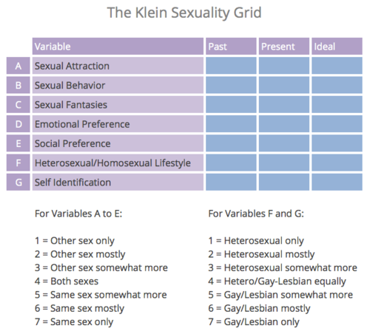
THEORIES OF PSYCHOSEXUAL DEVELOPMENT: Multidimensional model
Criticism of such linear, staged models of development arose due to observations that bisexual individuals and lesbians were less likely than gay men to progress linearly through these stages. Instead research suggested a more dynamic, ongoing developmental process for these individuals over time.
Diamond, L.M., A NEW VIEW OF LESBIAN SUBTYPES: STABLE VERSUS FLUID IDENTITY TRAJECTORIES OVER AN 8-YEAR PERIOD. Psychology of Women Quarterly, 2005. 29(2): p. 119-128.
Klein, F., Homosexuality/Heterosexuality: Concepts of Sexual Orientation. 1990: p. 277-282.
Notes:
Fritz Klein (1980s) – multidimensional model of psychosexual development– theory that multiple aspects of sexual orientation and identity can change independently of others over time. Spurred other theorists (Lisa Diamond e.g.) to consider how various subgroups (e.g. lesbians) might develop differently over time.

Slide 17
THEORIES OF PSYCHOSEXUAL DEVELOPMENT: Life course
Recent theorists have proposed a so-called “life course” conceptualization of sexual identity development as including partly biologically driven sexual desires, attractions, and romantic feelings, with internalization of social attitudes and identity labels, and choice and free agency with regard to subsequent development of identity (choosing how and when to self-label, relationships, sexual behavior, et cetera).
Hammack, P.L., The Life Course Development of Human Sexual Orientation: An Integrative Paradigm. Human Development, 2005. 48: p. 267–290.
Hammack, P.L., E.M. Thompson, and A. Pilecki, Configurations of identity among sexual minority youth: context, desire, and narrative. J Youth Adolesc, 2009. 38(7): p. 867-83.

Slide 18
Ethnic and Racial Differences
Rosario et al showed no significant differences in Latino, Black or White youth in sexual development milestones, sexual orientation, sexual behavior, or sexual identity between groups.
Cultural factors may delay integration of GBL identity due to heightened prejudice.
Rosario et al 2004, Cultural Diversity and Ethnic Minority Psychology 10, 215-28; and 1996 J Sex Research 33,113-26
Notes:
Peter

Slide 19
DEVELOPMENTAL CHALLENGES
1. Teenagers face adversity based upon their sexual orientation and gender expression that can lead to increased rates of depression and anxiety over the teenage years for some.
2. Minority adolescents might seek to hide certain aspects of their identity in order to better fit in. This is usually done in ways so as to limit exposure to shame and victimization, but can lead to sensitization to shame, increased fear of victimization, and social isolation.
3. Attention should be paid to the development not only of the sexual minority youth but also the family, which is also rapidly changing to accommodate their loved one. At times family will struggle to find how to accept their loved one for who they are.
Notes:
Minority stress paradigm was developed by Ilan Meyer (2003) regarding how broad societal forces impact development in sexual minority youth.

Slide 20
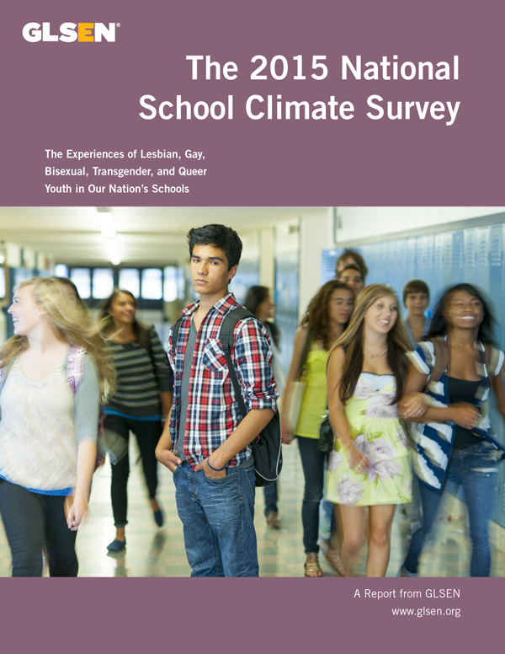
DEVELOPMENTAL CHALLENGES
70% of sexual minority students reported verbal harassment.
27% of sexual minority students reported physical harassment.
32% missed at least 1 day of school due to feeling unsafe or
uncomfortable at school due to their sexual orientation.
Rural students were at higher risk of victimization than urban or
Suburban youth.
Notes:
N = 10 528, ages 13-21, grades 6-12.
From executive summary:
In 1999, GLSEN identified that little was known about the school experiences of lesbian, gay, bisexual, transgender, and queer (LGBTQ) youth and that LGBTQ youth were nearly absent from national studies of adolescents. We responded to this national need for data by launching the first National School Climate Survey, and we continue to meet this need for current data by conducting the study every two years. Since then, the biennial National School Climate Survey has documented the unique challenges LGBTQ students face and identified interventions that can improve school climate. The survey documents the prevalence of anti-LGBT language and victimization, such as experiences of harassment and assault in school.
“Schools nationwide are hostile environments for a distressing number of LGBTQ students, the overwhelming majority of whom routinely hear anti-LGBT language and experience victimization and discrimination at school. As a result, many LGBTQ students avoid school activities or miss school entirely.

Slide 21
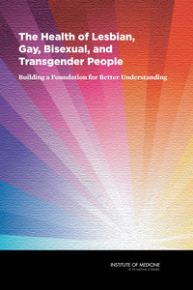
DEVELOPMENTAL Challenges: Health disparities
LGBT youth are between 1.8 to 2.9 times more likely to develop
major depression, generalized anxiety, or conduct disorder and more likely to experience suicidal thoughts or actions.
2015 Youth Risk Behavior Survey (YRBS), Ages 14-17
 | Suicidal Thoughts (%) | Suicide Plan (%) | Suicide Attempts (%)
Heterosexual | 14.8 | 11.9 | 6.4
Lesbian-Gay-Bisexual | 42.8 | 38.2 | 29.4
Not Sure | 31.9 | 27.9 | 13.7
N=15,600
Kann L, Olsen EO, McManus T, Harris WA, Shanklin SL, Flint KH, et al. Sexual Identity, Sex of Sexual Contacts, and Health-Related Behaviors Among Students in Grades 9-12 - United States and Selected Sites, 2015. Morbidity and mortality weekly report Surveillance summaries (Washington, DC : 2002). 2016;65(9):1-202.
Notes:
IOM Ground-breaking Monograph:
Institute of Medicine, The National Academies Collection: Reports funded by National Institutes of Health, in The Health of Lesbian, Gay, Bisexual, and Transgender People: Building a Foundation for Better Understanding. 2011, National Academies Press (US) National Academy of Sciences.: Washington (DC).
Sizable literature noting elevated risk taking and poorer health status among youth who have same sex attractions, experience same-sex sexual relationships, and/or identify as LGBT.
Important contributors: stigma, harassment, victimization, witnessing/perpetrating violence.
Remafedi ‘91: 36,741 MN students grades 7-12. LGB have increased risk. Highest risk: effeminate boys, and boys who identify at earlier ages.
Savin Williams: Unclear if those who come out earlier have more conflicts, or are less well equipped to handle the pressure- so coming out does not always lead to better mental health.
Add Health Study : 12,000 youth studied by Russell and Joyner: “regardless of age and family background more likely than peers to report suicidal thoughts”.
YRBS 2015. First survey to include questions on sexual identity. “Nations are judged by the health and well-being of their children,” said Dr. Jonathan Mermin, who is the director of the National Center for HIV/AIDS, Viral Hepatitis, STD, and TB Prevention at the C.D.C. “Many would find these levels of physical and sexual violence unacceptable and something we should act on quickly.” … While the figures paint a portrait of loneliness and discrimination that is longstanding and sadly familiar, they are important because they now establish a national databank. [“Gay and Lesbian High school Students Report ‘Heartbreaking’ Levels of Violence.” J Hoffman, 8/11/16, NYT]

Slide 22
Developmental challenges
Legalizing same-sex marriage was associated with fewer youth suicide attempts, new study finds
By Ben Guarino Morning Mix
February 21, 2017
“Stigma is one of the most frequently hypothesized risk factors for explaining sexual orientation disparities in suicide outcomes,” wrote Columbia University’s Mark L. Hatzenbuehler in a JAMA Pediatrics editorial accompanying the study.
Although the majority of high school students do not have immediate plans to get married, legalizing “same-sex marriage reduces structural stigma associated with sexual orientation,” Raifman said.
Notes:
Legalization of same-sex marriage in a state was associated with a relative risk reduction in suicide attempts for ALL students, and a more significant relative risk reduction of 14% for sexual minority students. This demonstrates how social acceptance and reduction in stigma for sexual minorities affects the mental health of individual youths.
Raifman J, Moscoe E, and SB Austin. Difference-in-differences analysis of the association between state same-sex marriage policies and adolescent suicide attempts.
JAMA Pediatr. 2017;171(4):350-356. doi:10.1001/jamapediatrics.2016.4529

Slide 23
“The nature of injustice is that we may not always see it in our own times” [Kennedy, 2015]
Cultural attitudes towards LGBTQ people have shifted towards tolerance/acceptance/inclusion over past 30 years.
Changes in law and public policy have made it possible for LGBTQ families to form and participate in social spheres once reserved for married heterosexual couples.
Recent US Supreme Court ruling that marriage is a fundamental right that must be recognized in all states.
Notes:
Taken from new chapter on Gay Fatherhood with Tam Woodrum
Obergefell v. Hodges Supreme Court Decision: Cincinnati man at the center of this historic decision was a guest at President Obama's final State of the Union speech. Obergefell married his partner of 20 years John Arthur in 2013- flying to Maryland where marriage was legal for a 7.5 minute ceremony on the tarmac. Arthur was in the final stages of ALS, and his aunt performed the ceremony on the plane.
The Supreme Court acknowledged that the long history of discrimination against same sex couples could no longer be justified in the face of advances in our understanding of sexuality as an immutable characteristic. Times have changed!!!! Growing up in Bismarck, ND, I never thought folks like me could get married to other men, have kids, etc….The US Army is now led by an openly Gay Man! The military has ended “Don’t ask don’t tell” and did not fall apart in spite of dire warnings….and now is accepting trans men and women…
Stigma from legally sanctioned discrimination can linger long after legal reform because it is entrenched throughout the culture and enacted across a variety of personal interactions with state and federal agencies (Goldberg et al., 2014). Even as laws change, the “heteronormativity” remains the de-facto standard of “normal” or, as one author describes, “[t]he entrance card to being a parent within established legal systems” (Lev, 2010, p. 347).

Slide 24
Notes:
And Tango Makes Three is a 2005 children's book written by Peter Parnell and Justin Richardson and illustrated by Henry Cole. The book is based on the story of Roy and Silo, two male chinstrap penguins in New York's Central Park Zoo. Roy and Silo were observed performing behaviors typically seen in penguin couples, such as bowing to one another. Roy and Silo made a nest together, and seemed to be trying to hatch a rock that resembled an egg. When zookeepers realized that these two males had formed a couple, they gave them an egg to hatch. This egg was obtained from a male-female penguin couple, named Betty and Porkey, who had two eggs and could not care for both at once. Roy and Silo took turns sitting on the egg, and eventually it hatched. The female chick was named "Tango" by the zookeepers.
The book has won many awards but also been at the center of numerous censorship and culture war debates on same-sex marriage, adoption, and homosexuality in animals. The American Library Association reports that And Tango Makes Three was the most challenged book of 2006 to 2010, except for 2009 when it was the second most challenged. The book is listed on the "15 Most Controversial Picture Books" because of the controversy surrounding the popular children's book. A school librarian in Massachusetts feared losing her job after introducing the book to students.
In Ankeny, Iowa parents at the local elementary school asked in 2008 that this book be placed in a restricted section of the library so only parents could check it out. The school district's lawyer argued that such a decision, if challenged, would likely not hold up in court. PEN America and the American Library Association sent letters urging the board to preserve students' access to Tango. On 12/15/08 the Ankeny school board voted 6 to 1 to keep the book in general circulation. [Wikipedia]

Slide 25
DEVELOPMENTAL CHALLENGES
1. Adolescence is a time of identity consolidation, including multiple identities, and the intersectionality of these multiple identities. At times teens may struggle to consolidate various aspects of their identity that seem incongruent, which can lead to angst.
2. Minority adolescents might seek to hide certain aspects of their identity in order to better fit in. This is usually done in ways so as to limit exposure to shame and victimization, but can lead to sensitization to shame, increased fear of victimization, and social isolation.
3. Attention should be paid to the development not only of the sexual minority youth but also the family, which is also rapidly changing to accommodate their loved one. At times family will struggle to find how to accept their loved one for who they are.

Slide 26
DEVELOPMENTAL CHALLENGES
“I remember going home at night and crying myself to sleep because I knew that I was different, and I was terrified of being different”
“I felt different. … [because my] mother is very, very anti-gay and [my] father is as well. I hated it. I did not want to be gay at all, ever. Because … it made me an outcast. Everywhere I had to be constantly careful about what I did and I [could not] cope with it at all”
“I mean you can … pretend to be heterosexual as much as you like, but, when push comes to shove, … [it is difficult] to … create this big lie all the time, you know, live this lie”
Flowers, P. and K. Buston, “I was terrified of being different”: exploring gay men's accounts of growing-up in a heterosexist society. Journal of Adolescence, 2001. 24(1): p. 51-65.
Notes:
Internalized homophobia as Minority stress.
“Passing” versus “covering”

Slide 27
DEVELOPMENTAL CHALLENGES
1. Adolescence is a time of identity consolidation, including multiple identities, and the intersectionality of these multiple identities. At times teens may struggle to consolidate various aspects of their identity that seem incongruent, which can lead to angst.
2. Minority adolescents might seek to hide certain aspects of their identity in order to better fit in. This is usually done in ways so as to limit exposure to shame and victimization, but can lead to sensitization to shame, increased fear of victimization, and social isolation.
3. Attention should be paid to the development not only of the sexual minority youth but also the family, which is also rapidly changing to accommodate their loved one. At times family will struggle to find how to accept their loved one for who they are.

Slide 28
Family DEVELOPMENTAL CHALLENGES
Families typically experience stress around the time of “coming out”, that is an adolescent disclosing his or her identity to a family member in middle to late adolescence.
“If people have been in a car accident we ask if they were hurt, how much damage there was to the car, whether or not it will be covered by insurance, et cetera. We had no script for this experience”
“[I am] grieving here. I feel as if I lost my son. I wanted him to get married, have children—I want grandchildren—a house. But now that [is not] going to happen. I have lost all of those dreams I had for my son, because [they are] not going to come true. [He is] never going to have a wife and kids and a house like I wanted him to”
Fields, J., Normal Queers: Straight Parents Respond to Their Children's "Coming Out". Symbolic Interaction, 2001. 24(2): p. 165-187.
Grafsky, E.L., Becoming the Parent of a GLB Son or Daughter. J GLBT Fam Stud, 2014. 10(1-2): p. 36-57.
Notes:
Society typically prepares parents for handling circumstances that might arise – but not typically for this.
Parents have their own fantasies about what their children’s future will look like, typically around the heterosexual paradigm.
Important to notice that some of the fears families have may be exaggerated and catastrophic. These might be amenable to intervention.

Slide 29
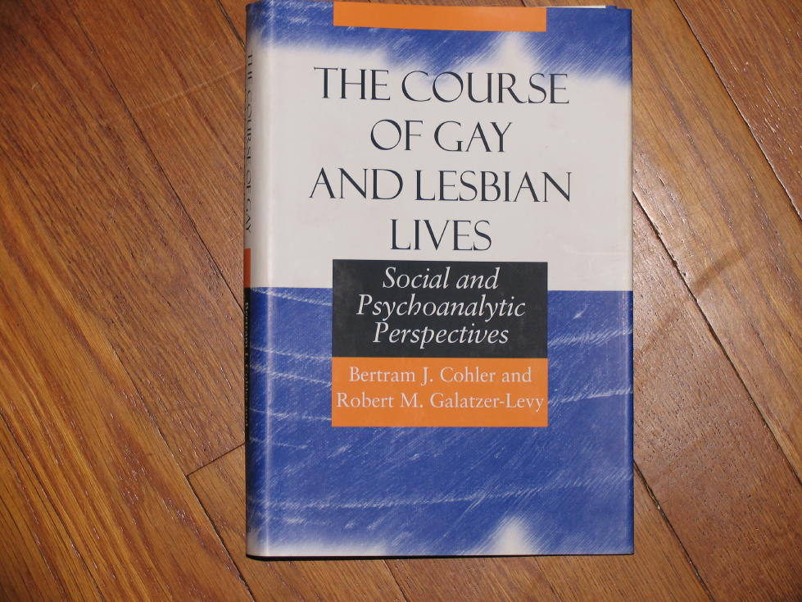
Well-adjusted: Galatzer Levy
“It is important that society as a whole come to terms with this new generation of well adjusted, competent young men and women, who differ from their peers in terms of sexual orientation but little else”
Notes:
[The Course of Gay and Lesbian Lives- social and psychoanalytic perspectives. U Chicago Press 2000]

Slide 30
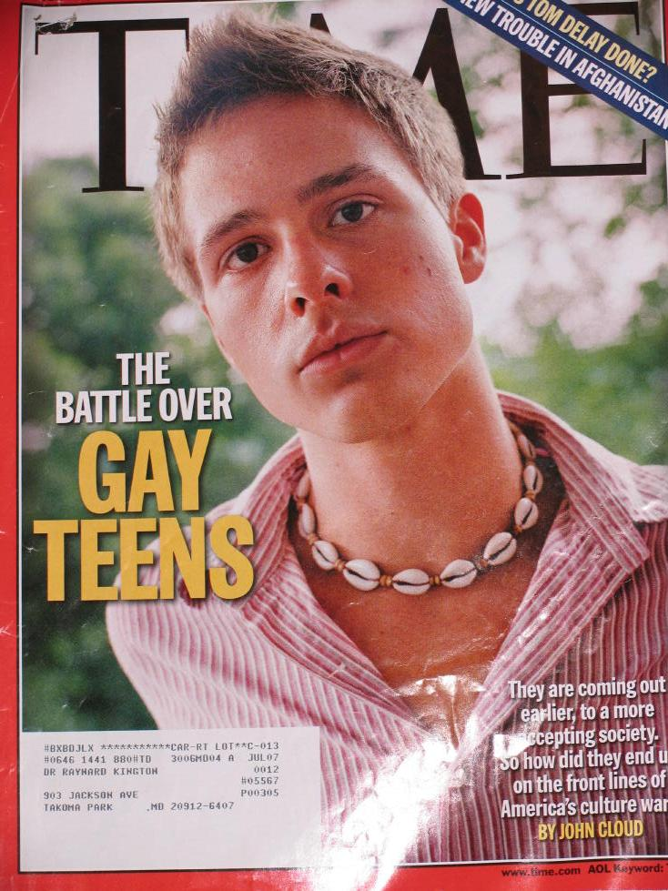
Diverse & resilient
Savin Williams: … “they are more diverse than they are similar, and more resilient than suicidal”. Way back in Times 10/05 Cover Story on Gay Teens, he argued that such youth are increasingly not defining themselves by their sexuality…

Slide 31
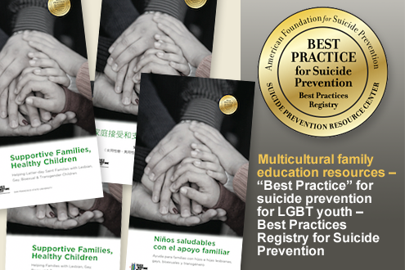
Helping youth and families
MOST sexual minority adolescents and young adults will never develop problems with mental health, substance abuse, or health risk behavior.
However, more will than their strictly heterosexual peers, likely attributable to internal and external stressors.
Evidence-based psychosocial interventions are limited though psychotherapy addressing individual and family beliefs and meaning about sexual orientation and building psychosocial support for the individual is generally accepted. Early data from the Family Acceptance Project created by Caitlyn Ryan is promising as an intervention for mental health outcomes and health risk behaviors.
Institute of Medicine Committee on Lesbian, G.B., et al., The National Academies Collection: Reports funded by National Institutes of Health, in The Health of Lesbian, Gay, Bisexual, and Transgender People: Building a Foundation for Better Understanding. 2011, National Academies Press (US) National Academy of Sciences.: Washington (DC).

Slide 32
REVIEW
The explanation for variation in sexual orientation and identity development has not been fully worked out but, when it is, it will be complex and encompassing multiple facets (biology, psychology, social-cultural…).
Babies and children - although not asexual- do not have inborn traits identifiable as sexual orientation or identity (though there may be some differences noticeable even in early childhood).
The pathways by which children grow into sexual minority adults are not the same, nor do they need to be, as this allows for a rich narrative approach to engaging teenagers, young adults, and families.
Teenagers, young adults, and families have emotional reactions to a non-heterosexual identity. The stigma, shame and victimization that might follow can lead to great angst & various clinical presentations (depression, anxiety, substance use, even self-injury/suicide).
Families can and often do learn to accept their loved one who is a sexual minority and provide needed social support to prevent negative mental health outcomes.

Slide 33
Families & acceptance
When describing her son asking her to pull the car over because he needed to tell her something, one mother said: “At this point, I am getting a little nervous….his eyes start to get misty and [I am] like, Oh God, [he has] gotten a girl pregnant… and then he just looks at me and out of his mouth comes, [I am] gay. When I get taken by surprise I start to turn red from my chest up and I could feel heat and redness just rising; [I cannot] tell if [he is] joking, [I cannot] tell if he is serious. And I look at him and then I see the tears in his eyes. He starts crying and I start crying and [I am] just like, ‘[that is] all you had to tell me?’”
Notes:
From Lewis 16 draft, shortly before conclusion

Slide 34
Thoughts? Questions? Discussion guide:
How can schools and caregivers create safe and welcoming spaces?
How should schools best respond to intolerance/bullying?
What is the role of Gay Straight Alliances:
GLOW in Iowa City
Origins of GSA’s
Membership of GSA
Notes:
GLOW: Gay, Lesbian, or Whatever

